Slide 1
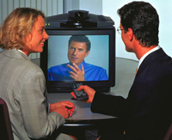
Computers Are Your Future
© 2006 Prentice-Hall, Inc.

Slide 2

Computers Are Your Future
Chapter 6
Inside the System Unit
© 2006 Prentice-Hall, Inc
Slide <number>

Slide 3
What You Will Learn . . .
Understand how computers represent data
Understand the measurements used to describe data transfer rates and data storage capacity
List the components inside the system unit
List the components on the motherboard
How a CPU processes data
© 2006 Prentice-Hall, Inc
Slide <number>

Slide 4
What You Will Learn . . .
Factors that determine a microprocessors performance
The types and purpose of memory in a computer system
The physical connectors on the exterior of the system unit
© 2006 Prentice-Hall, Inc
Slide <number>

Slide 5
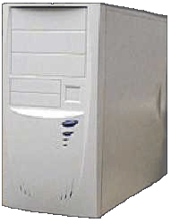
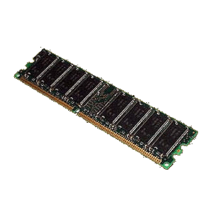
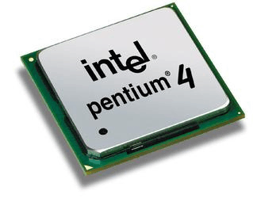
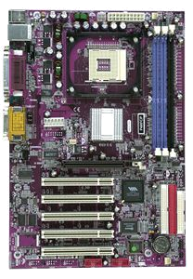
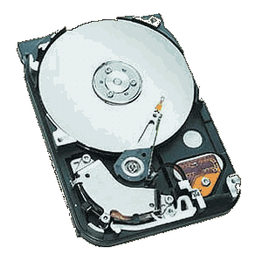
Describing Hardware Performance
Hardware performance refers to the amount of data a computer can store and how fast it can process the data
System Case
512 MB DDR SDRAM Memory Module
Mach Speed Socket 478 ATX Motherboard
Intel Pentium 4 2.4Ghz Processor
80 GB 7200 RPM Hard Drive
© 2006 Prentice-Hall, Inc
Slide <number>

Slide 6
How Computers Represent Data
OFF
ON
OFF
ON
OR
= 1 bit
0
1
= 1 Byte
OR
0
0
1
1
0
1
0
0
= 1 Byte
0
1
0
0
0
0
0
1
Bit (Binary digit) – On or off state of electric current; considered the basic unit of information; represented by 1s and 0s (binary numbers)
Byte – Eight bits grouped together to represent a character (an alphabetical letter, a number, or a punctuation symbol); 256 different combinations
© 2006 Prentice-Hall, Inc
Slide <number>

Slide 7
Bits
1000 bits = 1 kilobit (kb)
1,000,000 bits = 1 megabit (mb)
1,000,000,000 bits = 1 gigabit (gb)
Kilobits per second (Kbps), megabits per second (Mbps), and gigabits per second (Gbps) are terms that describe units of data used in measuring data transfer rates
  Example: 56 Kbps modem
© 2006 Prentice-Hall, Inc
Slide <number>

Slide 8
Bytes
8 bits = 1 Byte
1024 Bytes = 1 Kilobyte (KB)
1,048,576 Bytes = 1 Megabyte (MB)
1,043,741,824 Bytes = 1 Gigabyte (GB)
1,099,511,627,776 Bytes = 1 Terabyte (TB)
Kilobyte, megabyte, gigabyte, and terabyte are terms that describe large units of data used in measuring data storage
  Example: 20 GB hard drive
© 2006 Prentice-Hall, Inc
Slide <number>

Slide 9
Representing Characters: Character Codes
Character codes translate numerical data into characters readable by humans
  American Standard Code for Information Interchange (ASCII) – Eight bits equals one character; used by minicomputers and personal computers
  Extended Binary Coded Decimal Interchange Code (EBCDIC) – Eight bits equals one character; used by mainframe computers
  Unicode – Sixteen bits equals one character; over 65,000 combinations; used for foreign language symbols
ASCII
= 4
0
0
1
1
0
1
0
0
EBCDIC
= 4
1
1
1
1
0
1
0
0
© 2006 Prentice-Hall, Inc
Slide <number>

Slide 10
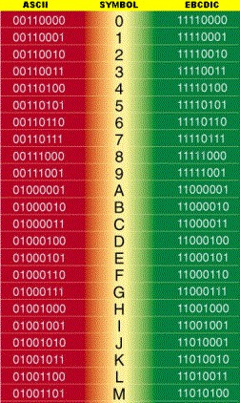
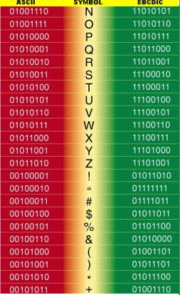
ASCII and EBCDIC Code
© 2006 Prentice-Hall, Inc
Slide <number>

Slide 11
© 2006 Prentice-Hall, Inc
Slide <number>

Slide 12
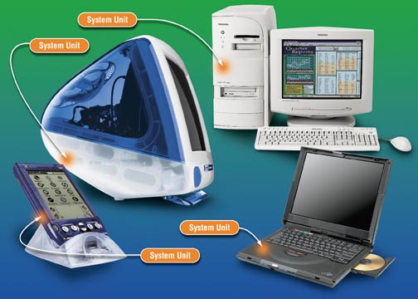
The System Unit
The system unit is a boxlike case that houses the computer’s main hardware components
A footprint is the space taken up on the desk by the computer
Form factor refers to the way the internal components are mounted in the unit
© 2006 Prentice-Hall, Inc
Slide <number>

Slide 13
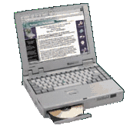
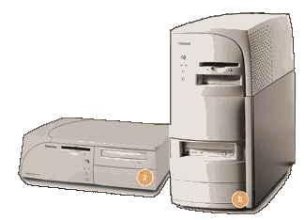

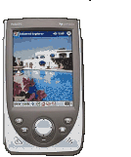
Types of System Units
Notebook
Desktop
Personal Digital Assistant
© 2006 Prentice-Hall, Inc
Slide <number>

Slide 14
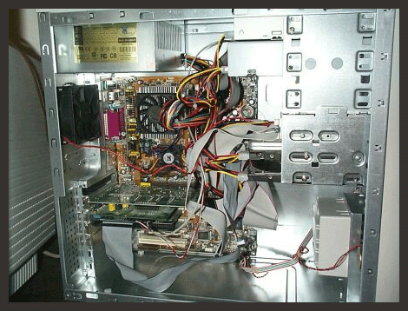
Inside the System Unit
Motherboard (mainboard) – Large printed circuit board with thousands of electrical circuits
Power supply – Transforms alternating current (AC) from wall outlets to direct current (DC) needed by the computer
Cooling fan – Keeps the system unit cool
Internal Speaker – Used for beeps when errors are encountered
Drive bays – Housing for the computer’s hard drive, floppy drive, and CD-ROM / DVD-ROM drives
© 2006 Prentice-Hall, Inc
Slide <number>

Slide 15
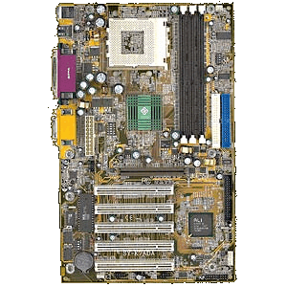
The Motherboard
The motherboard provides the centralized connection point for the computer’s components
  Most components are integrated circuits (chips)
    Chips carry electrical current and contain electronic switches or transistors
© 2006 Prentice-Hall, Inc
Slide <number>

Slide 16
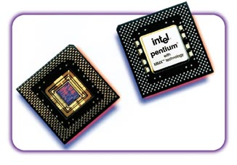
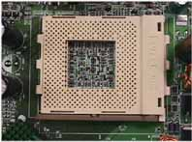
The Central Processing Unit:
The Microprocessor
CPU
CPU socket
Central processing unit (CPU) – A microprocessor that interprets and carries out instructions given by software. It controls the computer’s components
© 2006 Prentice-Hall, Inc
Slide <number>

Slide 17
Components of the CPU
Control unit – Coordinates and controls all parts of the computer system
Arithmetic-logic unit – Performs arithmetic or logical operations
Registers – Temporarily store the most frequently used instructions and data
© 2006 Prentice-Hall, Inc
Slide <number>

Slide 18
The Control Unit
The control unit manages four basic operations (fetch, decode, execute, and write-back)
  The four-step process is known as the machine cycle or processing cycle
  The processing cycle consists of two phases:
    Instruction Cycle
      Fetch – Gets the next program instruction from the computer’s memory
      Decode – Figures out what the program is telling the computer to do
    Execution Cycle
      Execute – Performs the requested action
      Write-back (Store) – Writes (stores) the results to a register or to memory
© 2006 Prentice-Hall, Inc
Slide <number>

Slide 19
The Arithmetic-Logic Unit
The arithmetic-logic unit (ALU) performs basic arithmetic and logic operations
  Adds, subtracts, multiplies, and divides
  Compares alphanumeric data
© 2006 Prentice-Hall, Inc
Slide <number>

Slide 20
Microprocessor Performance
Data bus width – The number of pathways within the CPU that transfer data; they are measured in bits (8, 16, 32, or 64)
Word size – The maximum number of bits of data that the CPU can process at one time (8 bits, 16 bits, 32 bits, or 64 bits)
System Clock – electronic circuit that generates pulses at a rapid rate and synchronizes the computers internal activities
© 2006 Prentice-Hall, Inc
Slide <number>

Slide 21
Microprocessor Performance
Operations per cycle (clock speed) – The number of clock cycles per second measured in megahertz (MHz) or gigahertz (GHz)
  Superscalar operations – Carrying out more than one instruction per clock cycle
  Pipelining operations – Feeding a new instruction into the CPU at every step of the processing cycle
© 2006 Prentice-Hall, Inc
Slide <number>

Slide 22
Parallel Processing
Parallel processing involves using more than one CPU to improve performance
Complex instruction set computer (CISC) – A chip that includes special-purpose circuits that carry out instructions at high speeds
Reduced instruction set computer (RISC) – A chip with a bare-bones instruction set that results in a faster processing speed than CISC chips
© 2006 Prentice-Hall, Inc
Slide <number>

Slide 23
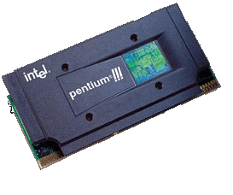
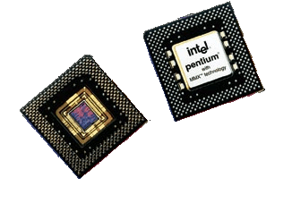
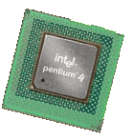
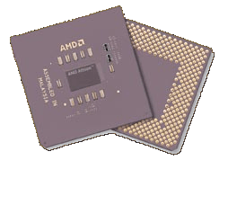
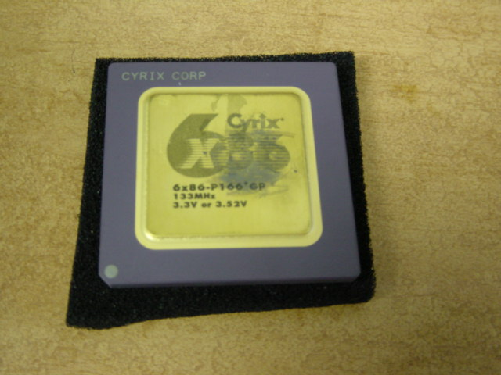
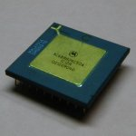
Popular CPUs
Advanced Micro Devices (AMD)
Intel
Pentium MMX
Pentium IV
Pentium III
Cyrix
Motorola (Apple)
© 2006 Prentice-Hall, Inc
Slide <number>

Slide 24
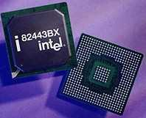
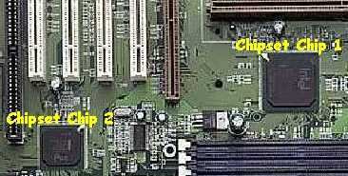
The Chipset
A chipset is a collection of chips that provide the switching circuitry needed to move data throughout the computer
© 2006 Prentice-Hall, Inc
Slide <number>

Slide 25
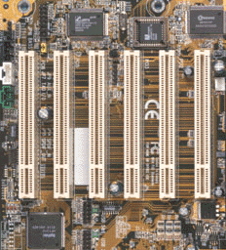
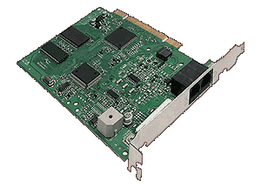
Input/Output Bus
PCI slots
The input/output bus provides a pathway so that the microprocessor can communicate with input/output devices
An input/output bus contains expansion slots which hold expansion cards
  PCI (Personal Computer Interface) slots are receptacles in which expansion cards are inserted. They support Plug and Play (PnP) devices.
Expansion Card
© 2006 Prentice-Hall, Inc
Slide <number>

Slide 26
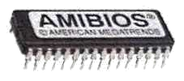
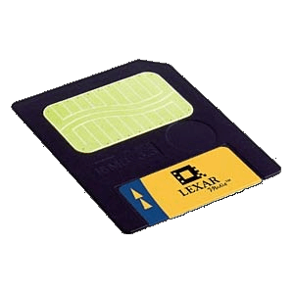
Memory
Read-Only Memory (ROM)
Random Access Memory (RAM)
Flash Memory
Memory is the term used to describe devices that enable the computer to retain information. Program instructions and data are stored in memory chips for quick access by the CPU.
© 2006 Prentice-Hall, Inc
Slide <number>

Slide 27
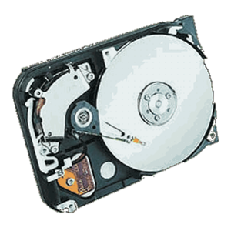
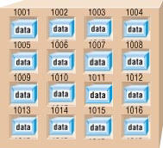
Virtual Memory
FULL
Virtual memory:
  Part of the hard disk is reserved as RAM
  When RAM modules become full, the CPU accesses the hard disk to store and retrieve data
Virtual memory is slower than RAM
© 2006 Prentice-Hall, Inc
Slide <number>

Slide 28

Random Access Memory (RAM)
RAM is a type of memory that stores information temporarily so that it’s available to the CPU
RAM is volatile; the memory’s contents are erased when the power is turned off
Each byte of memory has a unique location or memory address
© 2006 Prentice-Hall, Inc
Slide <number>

Slide 29
Types of RAM
Dynamic RAM (DRAM) – A memory chip that needs to be refreshed periodically or it will lose its data
  Synchronous DRAM (SDRAM) is synchronized with the computer’s system clock
  Rambus DRAM (RDRAM) uses a fast bus to send and receive data within one clock cycle. It is faster than SDRAM
  Double data rate SDRAM (DDR SDRAM) is a type of SDRAM that can send and receive data within one clock cycle
© 2006 Prentice-Hall, Inc
Slide <number>

Slide 30
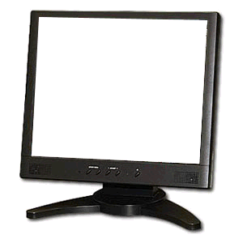
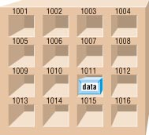

Processing a Word
CLICK ONCE TO BEGIN ANIMATION
MONITOR
W
E
B
RAM
KEYBOARD
B
W
E
B
B
E
E
W
W
CPU
© 2006 Prentice-Hall, Inc
Slide <number>

Slide 31
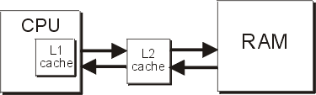
Cache Memory
Primary cache (Level 1 or L1) – Located within the CPU chip, it is the memory that the microprocessor uses to store frequently used instructions and data
Secondary cache (Level 2 or L2; Backside Cache) – Located near the CPU, it is the memory between the CPU and RAM
Cache memory is faster than RAM
© 2006 Prentice-Hall, Inc
Slide <number>

Slide 32
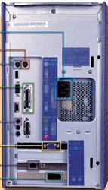
Outside the System Unit
Drive bays
On/off switch
Reset button
BACK
Indicator lights
FRONT
The front panel contains drive bays, various buttons, and indicator lights
Connectors and ports are physical receptacles located on the back to connect peripheral devices to the computer
© 2006 Prentice-Hall, Inc
Slide <number>

Slide 33
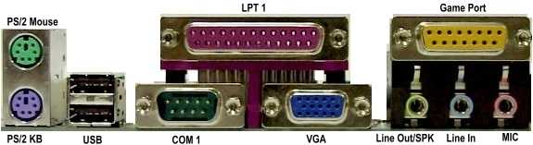
Types of Connectors
Point and click on a connector below to view information about it.
Click again to remove the text.
PS/2 port (mouse port) – Special serial port to connect mouse.
PS/2 port (keyboard port) – Special serial port to connect keyboard.
Universal Serial Bus (USB) – Allows up to 127 devices to be connected at a time.
Serial port – Data flows in a series of pulses, one after another one bit at a time; slow data transfer rate.
Parallel port – Data flows through eight wires allowing the transfer of eight bits of data simultaneously; faster than serial ports.
VGA connector – A 15 pin connector used for monitors
Game port – A connector for high speed access for graphics-intensive interaction.
Sound card connectors – Also called jacks, sound card connectors accept stereo mini-plugs. Microphone, line-in, line-out, and speaker connectors are plugged into the card.
© 2006 Prentice-Hall, Inc
Slide <number>

Slide 34
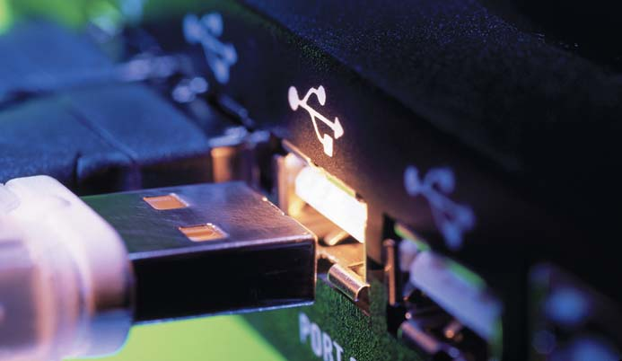
Other Types of Connectors
Small computer system interface (SCSI) port – A parallel interface that enables up to eight devices to be connected to it
1394 (FireWire) port – A high-speed connection for up to 63 devices
Infrared Data Association (IrDa) port – Infrared signals are used to communicate between peripheral devices and the system unit
© 2006 Prentice-Hall, Inc
Slide <number>

Slide 35
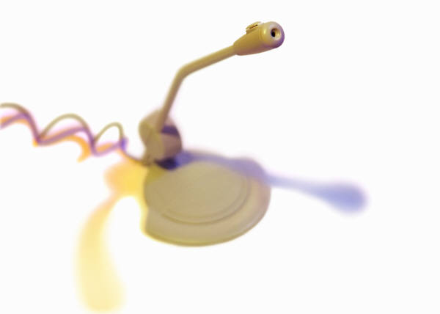
Additional Ports and Connectors
Telephone – modem interface
Network – larger than telephone jack
PC card slot – notebook computers have slot for PC cards
Sound card connectors –
  Mic – microphone input
  Line In – input from audio devices
  Line Out – output to another audio device
  Speaker – output to external speakers
TV/sound capture – turns computer into a TV tuner
© 2006 Prentice-Hall, Inc
Slide <number>

Slide 36
Chapter 6 Summary
The basic unit of information is the bit
Large units of data are called kilobytes (KB), megabytes (MB), gigabytes (GB), and terabytes (TB)
The system unit contains the motherboard, which is a circuit board that provides receptacles for chips and input/output buses
The central processing unit (CPU) contains the control unit (CU) and the arithmetic-logic unit (ALU). It manages the four basic operations (fetch, decode, execute, and write-back).
The CPU processes data in a four-step cycle called a machine cycle. The CU manages four basic operations: fetch, decode, execute, and store.
© 2006 Prentice-Hall, Inc
Slide <number>

Slide 37
Chapter 6 Summary continued
The CPU’s performance is measured by the data bus width, operations per second, speed, and cache memory
Random access memory (RAM) is the computer’s main memory. It is volatile.
There are various types of RAM, including dynamic RAM (DRAM), synchronous DRAM (SDRAM), Rambus DRAM (RDRAM), and double data rate (DDR) SDRAM
Computers have ports such as serial ports, parallel ports, SCSI ports, USB ports, FireWire ports, and IrDA ports to connect input/output devices
© 2006 Prentice-Hall, Inc
Slide <number>

